Slide 1
IMDB Movie Analyze

Slide 2
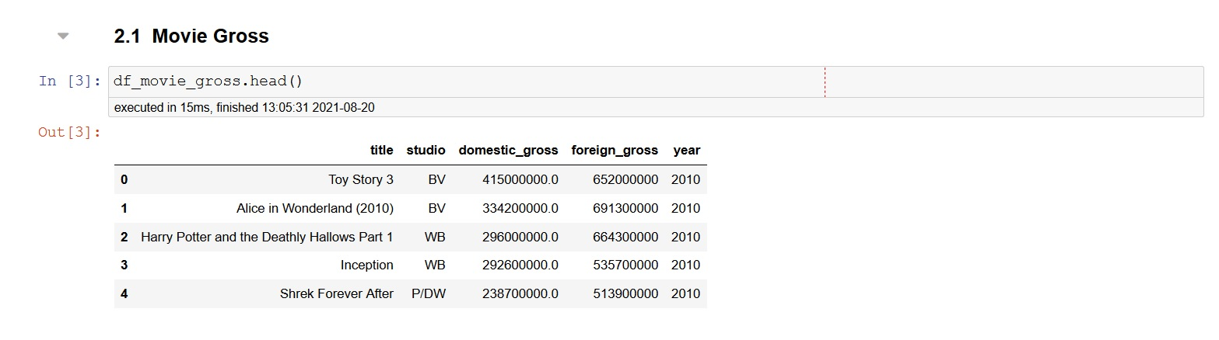
Looking inside the first dataframe as sample

Slide 3
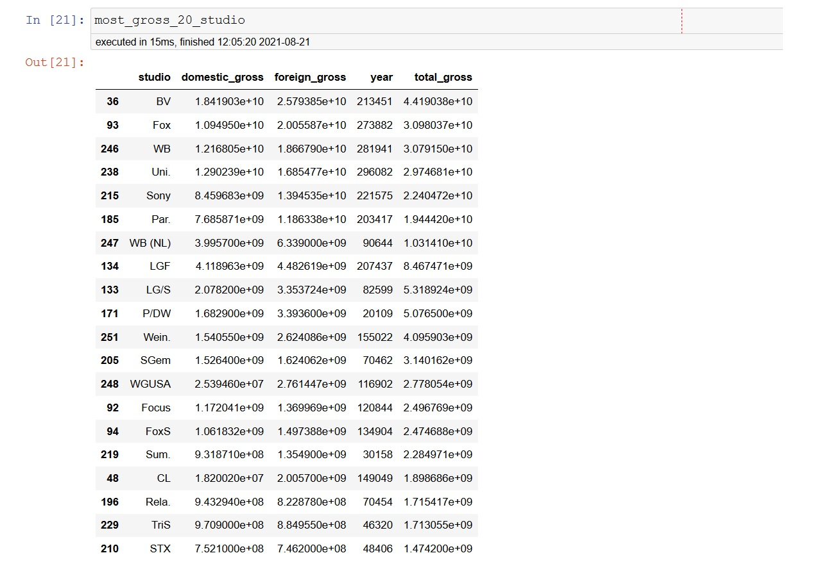
Highest-Grossing 20 Movie Studios
After a little bit work from movie gross dataframe
(previous slide) we can see highest-grossing top 20 studios.

Slide 4
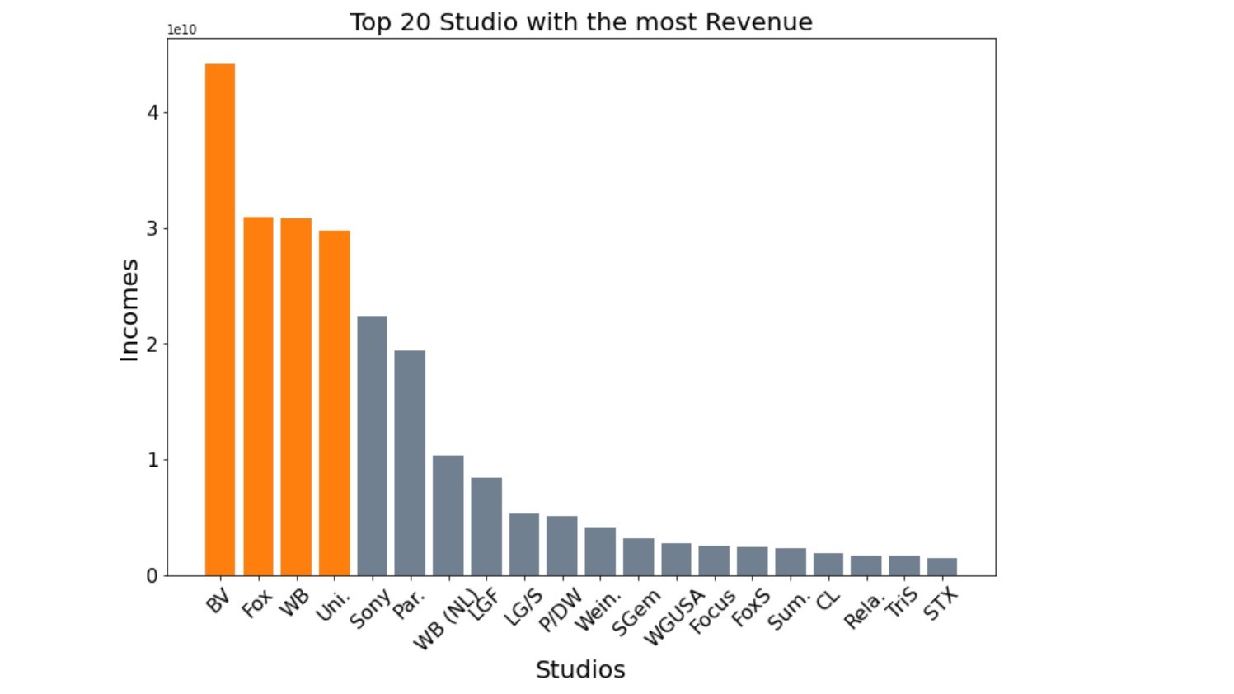
Top 20 Studios Graph
As we can see from this visualization BV,Fox,WB and Uni. Studios are the highest-grossing studios.

Slide 5
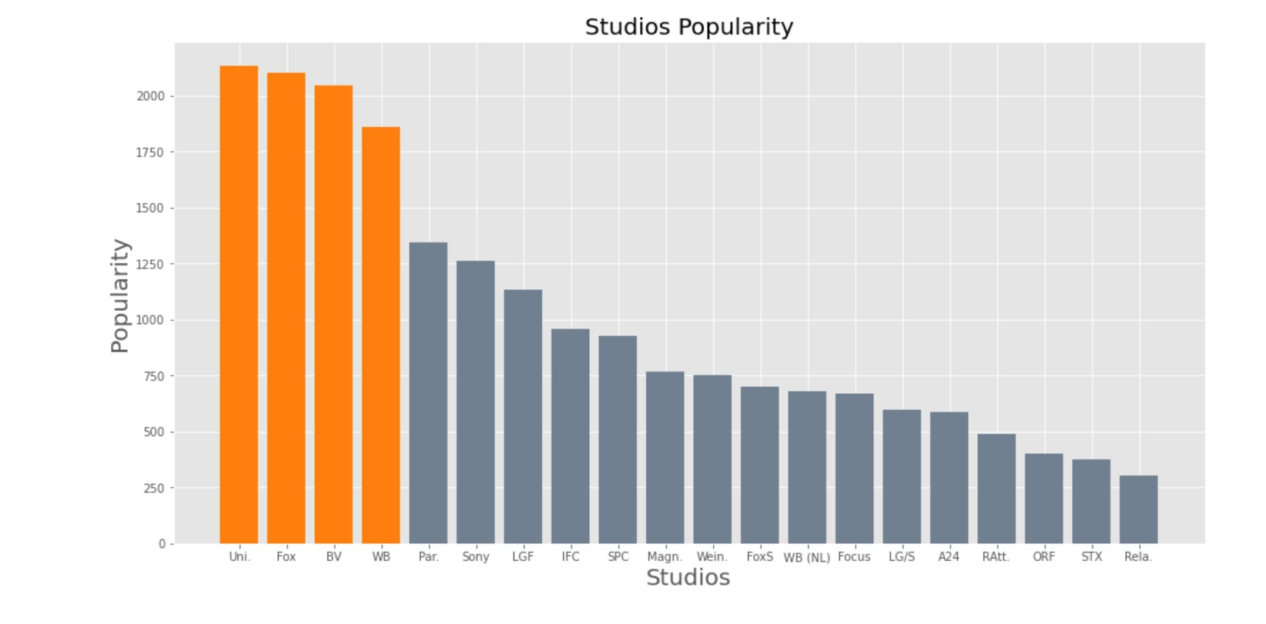
Studios Popularity
This graph supportive previous one to see if highest-grossing studios also most popular ones.

Slide 6
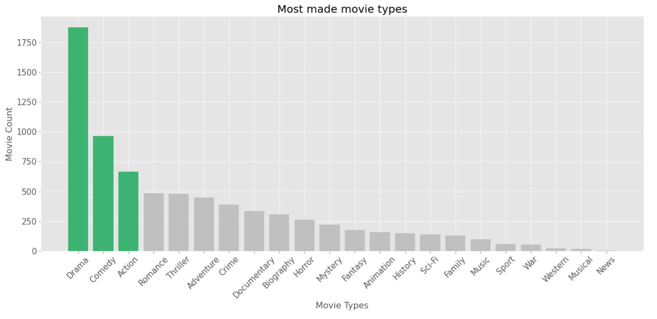
Looking the most made Movie Types

Slide 7
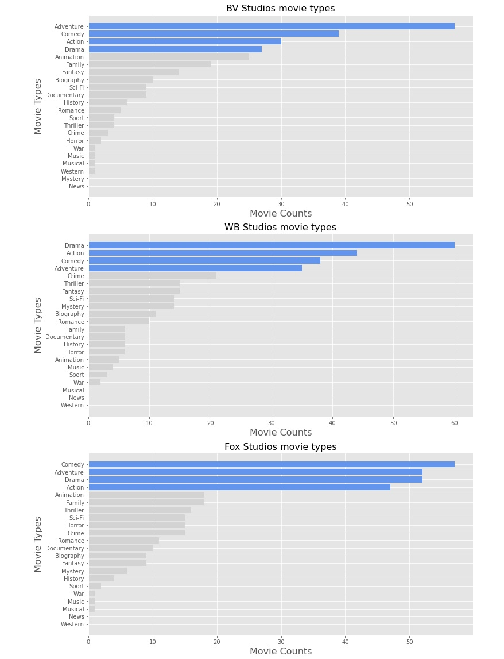
In here we wanted to show which first three of highest-grossing studios made type of movies.
And those types are ;
Adventure, Action, Drama and Comedy.

Slide 8
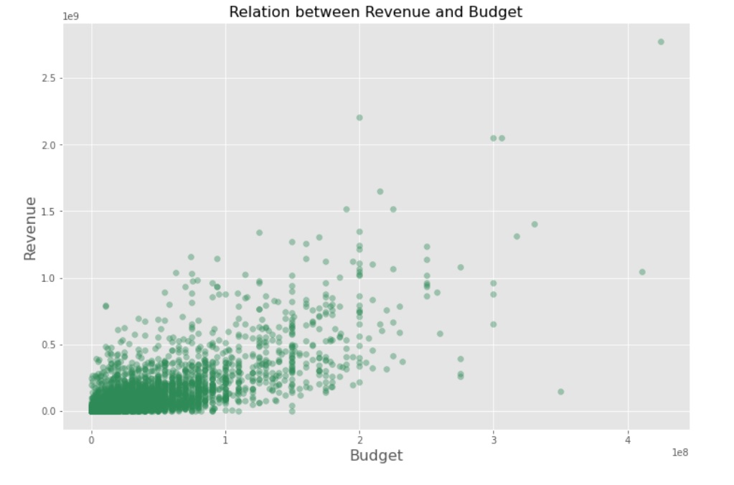
Budget-Revenue Relation
In this visualization is seen that the more budget provides the more revenue it comes.

Slide 9
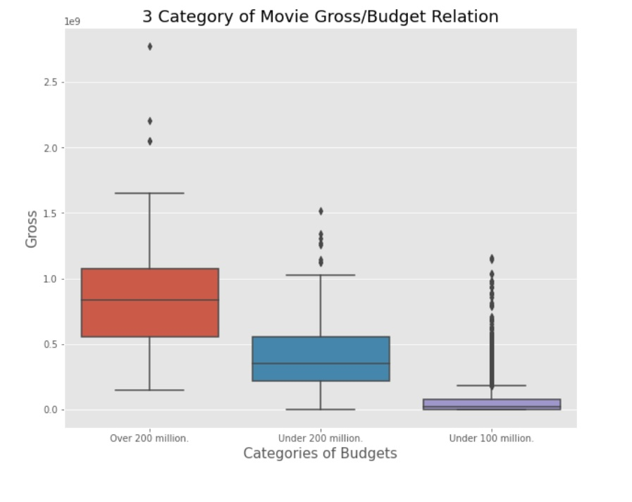
3 category of Budget-Revenue
In this graph easily could seen over 200 million category reaches the highest point of revenue
and under 100 million budget movies are the lowest revenue movies.

Slide 10
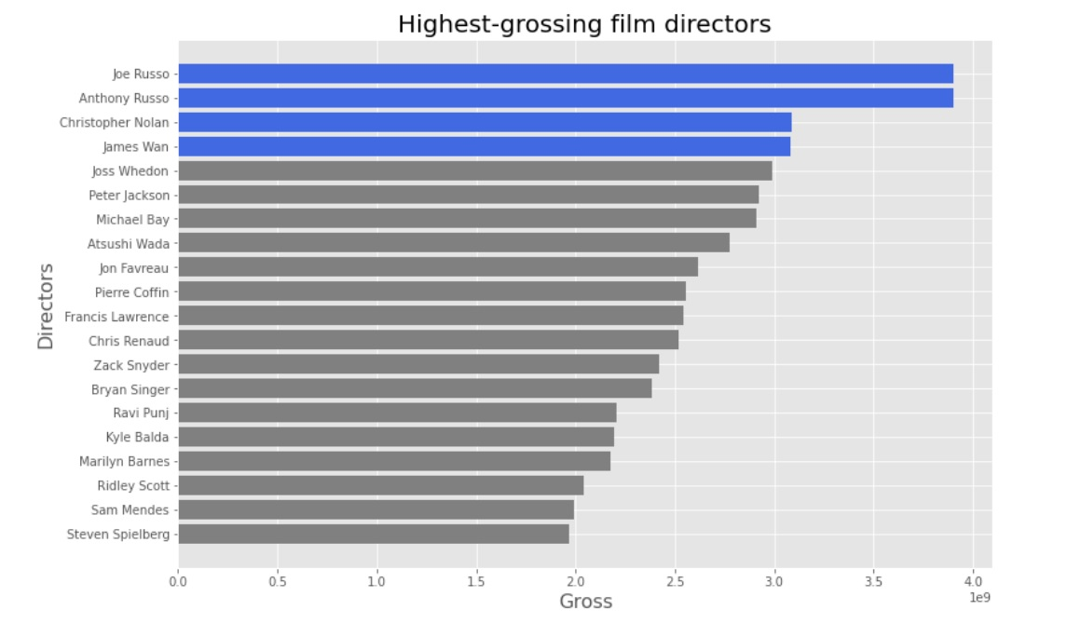
Highest-Grossing Directors

Slide 11
Conclusion
We can recommend to new studio to make movie with ;
one of these directors,
on action,adventure,comedy or drama.
And give as much as possible budget.
And further look what BV and Fox studios are doing to have most revenue and become most popular.

Slide 12


